Slide 1
Introduction
In general all industries are operating their machineries with induction motors.
All machines work on the principle of electromagnetism principle.
Whenever the current flowing thro a conductor , the magnetic field is produced around the conductor.

Slide 2
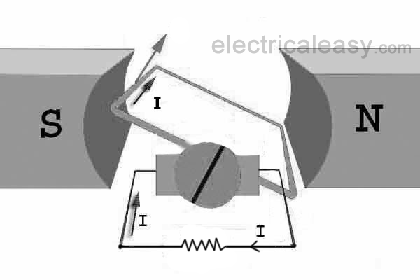
Faraday’s laws of electromagnetic induction
Whenever the change of flux over the coil (or) the moving coil linked with flux produces an induced emf in the coil.
( Eg. Generator , Transformer)
When the two flux lines
are interacted, a force is developed.
( Eg. Motor, Meters , etc.)

Slide 3
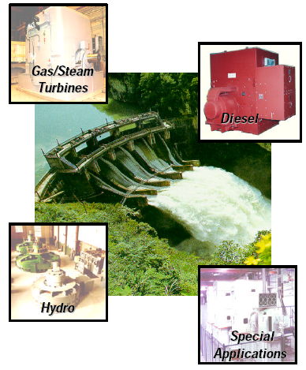
ALTERNATORS

Slide 4
Alternator - Construction
Standard construction consists of :
Armature windings on stationery stator
Field poles on rotor.
The field windings are excited by DC supply from the exciter and given through the slip rings
Prime mover

Slide 5
Advantages of rotating field and stationary armature type
High voltage generation
Better insulation
Rotor weight – less
Current collection - easy
Lesser number of slip rings

Slide 6
Types of alternators
Salient pole alternator
Non salient pole or Turbo or Cylindrical rotor alternator

Slide 7
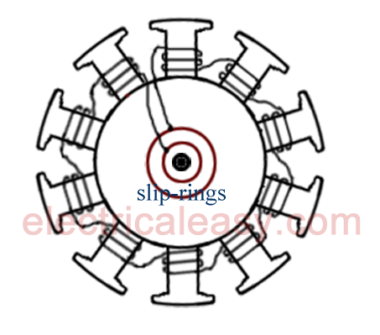
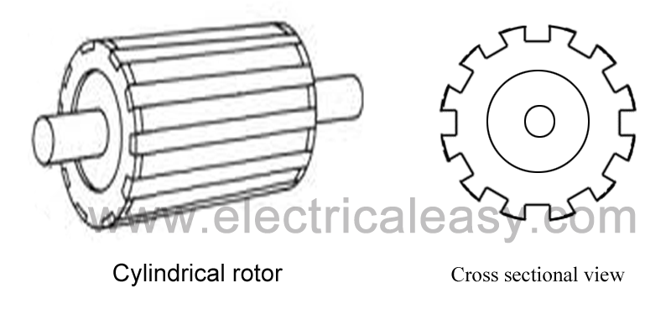
Rotor
Salient pole alternator Non salient pole or Turbo or Cylindrical rotor alternator

Slide 8
Salient pole type alternator
It consists of cast iron frame which supports the
silicon steel laminated ( bundling of thin sheets) armature core .
The core has slots on its inner periphery for housing the conductor .
Silicon steel material reduces the hysteresis loss and the lamination structure reduces the eddy current loss.
Suitable for low and medium speed alternator
( Ex Hydro alternator )

Slide 9
Advantages of a smooth cylindrical type rotor
Less windage loss
No need of damper winding
Good balancing of the rotor
Sound less running
Good cooling to the field because it is a distributed one.

Slide 10
Hunting
Due to inertia of the rotor, it can not achieve its final position instantaneously.
While achieving its new position due to inertia it passes beyond its final position corresponding to new load.
This will produce more torque. This will try reduce the load angle and rotor swings in other direction.
So there is periodic swinging of the rotor on both sides of the new equilibrium position, corresponding to the load. Such a swing is called hunting

Slide 11
Causes of hunting
Reduction of hunting
Due to sudden change in load
Due to fault conditions
Due to sudden change in field current
Due to cycle variation of the load torque
Damper winding reduces the hunting effect ( rotor oscillation due to fluctuation of load )
Use of Flywheel
increases the inertia of prime mover and maintains the rotor speed constant.

Slide 12
Effects of hunting
Causes variations of supply voltage
Increases the chance of loosing synchronizm
Increases the possibility of resonance
Huge mechanical stresses may be developed
Machine loss increases
Temperature of the machine rises

Slide 13
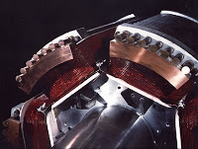
Damper winding
In the pole faces of the salient rotor, small holes are provided and copper bars are inserted in the slots.
The ends of all the bars in both sides are short circuited by copper rings to make closed circuit.
This winding is called as damper winding

Slide 14
Advantages of a smooth cylindrical type rotor
Less windage loss
No need of damper winding
Good balancing of the rotor
Sound less running
Good cooling to the field because it is a distributed one.

Slide 15
Comparison of Salient pole rotor and Cylindrical rotor
Sl.No | Salient pole rotor | Cylindrical rotor
1 | Large diameter | Smaller diameter
2 | Shorter axial length | Longer axial length
3 | Poles are projected | No projection . Smooth cylindrical one
4 | Need damper winding | No need
5 | It is suitable for low speed hydro Generator | Suitable for high speed turbo generator
6 | Windage loss is higher | lesser

Slide 16
Speed and Frequency
PN
F =
120

Slide 17
Different shapes of slots
Wide open
Semi closed
Closed

Slide 18
Terms used in armature winding
Conductor
End turn
Turn
Coil
Pole pitch : No of slots/no of poles
Coil pitch : it is the distance in slots between the centers of the two sides of a coil
Slot angle β = 180 degree / No of slots per pole

Slide 19
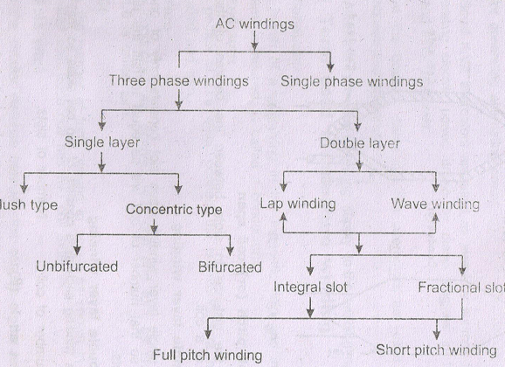
Different types of windings

Slide 20
Single layer winding :
Each slot consists only one coil side , so the number of coil will be equal to half the number of slots .
  Single layer mush winding
  Single layer concentric winding
Double layer winding :
Number of coils = No of slots
  Integral slot winding
  Fractional slot winding
Further classified into-
1. Full pitch winding 2. Short pitch winding

Slide 21
Advantages of chorded pitch winding
It saves copper of end connections
Reduction in resistance and inductance of the winding due to the lesser length of the coil ends
The wave form of the induced emf is improved
The distorting harmonics can be reduced
Due to elimination of high frequency harmonics eddy current and hysterisis losses are reduced , thereby increasing the efficiency
Mechanical strength of coil is increased

Slide 22
Phase spread
The phase spread of a winding is the proportion of circumference of the armature by one phase .
In a 3 φ winding for full pitch coils, each winding occupies a belt with a breadth equal to one third of a pole pitch or 60®.
With fractional number of slots per pole , the phase spread will have two values

Slide 23
Effects of distribution
In 3 phase winding, coils are placed in different slots under all pole . This is called distribution .
Due to this distribution, emf induced in each slot is not same .
Total voltage induced is the vector sum of voltages induced in the coil sides .

Slide 24
Advantages of distribution Winding
Harmonics are reduced
Induced voltage approached sinusoidal wave form
Armature reaction effect is reduced
Losses are reduced
Efficiency is improved
Provide better cooling

Slide 25
Pitch factor or Coil span (Kp or Kc )
Pitch factor (Kp) is defined as the ratio of vector sum of the induced emfs per coil to the arithmetic sum of induced emfs per coil .
Distribution factor (or ) breadth factor
If all the coil sides of any one pole are bunched in one slot , the winding is said to be concentrated winding . The total voltage is the airthmetic sum of emf induced in all the coils in one phase under the pole.
In order to obtain better wave shape the coils are not bunched in one slot . They are distributed in number of slots . This winding is known as distributed winding .

Slide 26
Derivation for Distribution factor
Let β be the slot angle ( 180 ®/ pole pitch )
M be the no of slots / pole /phase
Mβ be the phase spread angle
The emf induced in one pole group = mEs
In fig shows the procedure to find the vector sum of m emfs with a phase angel difference of β.
Here m=4 , if the m value is more than A,B,C,D,E curve forms a portion of circle with radius ‘ r ‘

Slide 27
Derivation for Distribution factor
From Fig AB = Es = 2.r.sin β/2
Vector sum = AE = Er = 2 r sin ( m β/2)
Vector sum of coil emf s
Kd =
Arithmetic sum of emfs
= 2 r sin ( m β/2) /(m * 2 sin β/2)
Kd = Sin (m β/2) / m * 2 r sin β/2

Slide 28
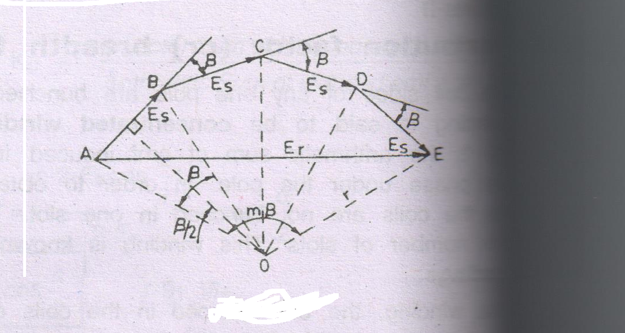
Vector sum of coils

Slide 29
Effect of pitch factor on EMF
Full pitch coil :
Coil span = Pole pitch (180⁰)
The emfs of two coil sides are in phase
Emf induced in a coil is equal to arithmetic sum of emf induced in each coil side .
Short pitched coil :
There will be a phase difference between the two coil sides . So emf induced in a coil is vector sum of the emfs induced in each coil side .
Therefore the emf induced in a short pitched coil is smaller than the full pitched coil .
The wave shape of emfs induced in the short pitched coils can be improved.

Slide 30
Harmonics
Harmonics are generated due to non-linear characteristics of devices like diodes, welding transformers etc
As the order and therefore the frequency of the harmonics increases, the magnitude normally decreases . Therefore lower order harmonics usually the fifth and seventh have the most effect on the power system .
THD total harmonic distortion is frequently used term to measure of the degree of harmonic distortion of the system .

Slide 31
Harmonics
The harmonics component will distort the fundamental sinusoidal wave .
Fundamental frequency = 50 Hz
Second order harmonics (50*2) = 100 Hz
Thrid order harmonics (50*3) = 150 Hz
Fourth order harmonics (50*4) = 200 Hz

Slide 32
Effect of Harmonics
Due to third harmonics zero sequence current is sharply increased and therefore neutral current increases .
The hysteresis loss and eddy current losses are increased according to frequency range , and so high frequency component of harmonics will heat the core . This effect will reduce the life of the equipment.
The fifth harmonics produces counter rotation and so the motor speed will reduce .

Slide 33
Effect of pitch factor on Harmonics
Emf induced in any coil is sinusoidal, if the flux is perfectly sinusoidal.
If the magnetic flux contains harmonics , the emf with harmonics are induced in the conductor
With full pitch coil, the coil span is 180⁰ for the fundamental field . The coil span is (3*180⁰) for the 3rd harmonic field and (5*180⁰) for the fifth harmonic field .
The harmonics present in the wave can be eliminated by proper selection of short pitching of coil.

Slide 34
Methods for sine wave
In general,
Emf induced in a conductor, e = BLV Sin θ
It depends upon the following factors
length of the conductor in the magnetic field(L)
Flux density of the magnetic field (B) and
Velocity of the conductor (V)
Methods: 1) Skewed pole method
2) Graded air gap method &
3) In nonsalient pole alternator – unslotted portion of the rotor is made equal to about 0.3 times pole pitch for best results.

Slide 35
Relation between electrical and mechancial degree
Degree electrical = Degree Mech * p / 2
Where p = number of poles

Slide 36
EMF equation of an alternator
Let,
P= No of poles.
F= Frequency of induced emf in Hz.
Φ= Flux per pole in wb.
N= Speed of the rotor in RPM.
Z= No of conductors in series per phase
Z= 2T , where T is the number of turns per phase
Kp (or)Kc = Pitch factor = cos α/2

Slide 37
  Sin (mβ/2)
Kd = Distribution factor =
m sinβ/2
Average emf /conductor = PΦ / (60/N)
Average emf / phase = Eph = 2Φfz volt (or ) 4φfT volts (if Z=2T)
RMS value
Form factor (Kf) = =1.11
Average value
RMS value of emf / ph = Eph = 1.11*2φfz
Kp and Kd reduces the actual voltage .
Hence E _{ph} = 4.44 KpKdfφT volts , where Z=2T.

Slide 38
Cooling and ventilation
The losses produced in the core and conductors of electrical machines are converted into heat . It raises the temperature of several parts of the machine . Hence cooling media is necessary to reduce the heat .
Different methods of cooling
Axial cooling , Radial cooling , Radial Axial cooling , & multiple inlet system of cooling

Slide 39
Cooling media
Air or Hydrogen
In case of slow speed alternators diameter is large and fan arrangements are provided with rotating member of the machine .
In case of high speed alternator, the natural cooling area available is very less , because the size of the alternator is small . By increasing cooling system , the output can be increased .

Slide 40
Hydrogen cooling
If air is used for cooling purpose in large size turbo alternators, a large quantity of air is required . For this , a large size fan is required to circulate the required air .
To reduce the size of the fan and also to improve the efficiency of the cooling system , hydrogen is used as cooling medium .

Slide 41
Conditions and advantages of hydrogen
Conditions:
Hydrogen should be pure.
Proper sealing should be provided.
Hydrogen should be maintained at certain pressure slightly above the atmosphere pressure
Advantages :
Reduction in windage loss due to low density of gas
The efficiency of machine is increased
Heat transfer capacity of Hydrogen is 1.3 times of air .
Noiseless operation is possible
No fire accident since hydrogen is inflammable
Life of the insulation is increased

Slide 42
Performance of an Alternator
Voltage drop in the winding is due to the following reasons.
  Ra
  Xl
  Xa
Resistance and reactance present in the alternator armature
The effective resistance is increased greater than the direct current Resistance . This is due to skin effect . R effective = 1.6 Rdc

Slide 43
Armature leakage reactance Xl
Current flows thro armature conductors.
Fluxes are set up which do not cross the air gap .
They take different paths .
Such flux are known as leakage fluxes
Leakage fluxes set up an emf is known as reactance emf .
The reactance which causes reactance emf is is known as leakage reactance

Slide 44
The Armature leakage fluxes are wasted in two ways-
Coil overhang leakage flux
Slot leakage flux

Slide 45
Armature reactance Xa
The voltage drop due to armature reaction is assumed to have fictitious reactance . This fictititous reactance is called armature reactance (Xa)
Synchronous reactance Xs -is the combined reactance of leakage reactance Xl and the fictitious reactance Xa due to armature reaction . Xs = Xl + Xa
Synchronous impedance Zs = √R_{EFF}² +X_{s}²

Slide 46
At no load condition there is no internal drop in the winding .
Terminal voltage per phase (v) is equal to the generated induced emf (E) per phase
ie V= E
On load E= V + I ( Ra+ jXl)

Slide 47
Armature reaction
The effect of armature flux due to armature current over the main field flux is called armature reaction
The armature flux will produce a distortion over the field current
The armature flux will oppose the main field flux or aid the main field flux .

Slide 48
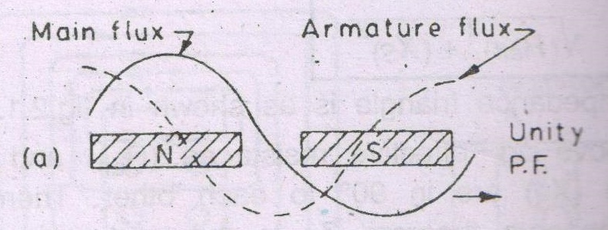
Armature reaction

Slide 49
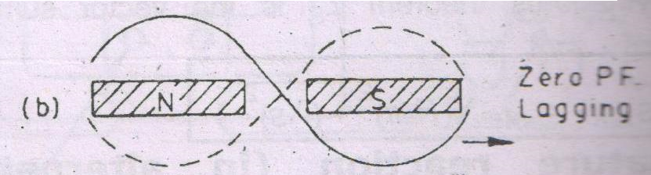
Armature reaction

Slide 50
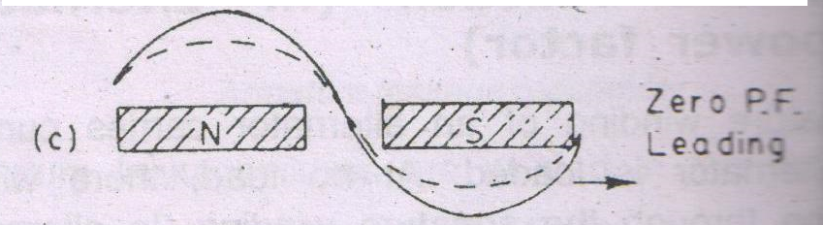
Armature reaction

Slide 51
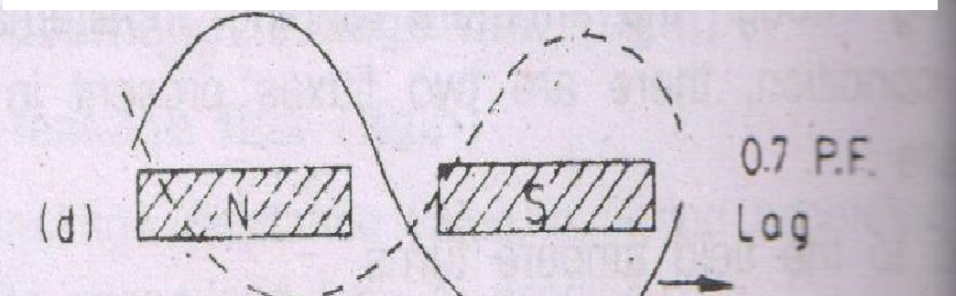
Armature reaction

Slide 52
Vector diagram of a loaded Alternator
1. for unity power factor
2. for lagging power factor
3. for leading power factor

Slide 53
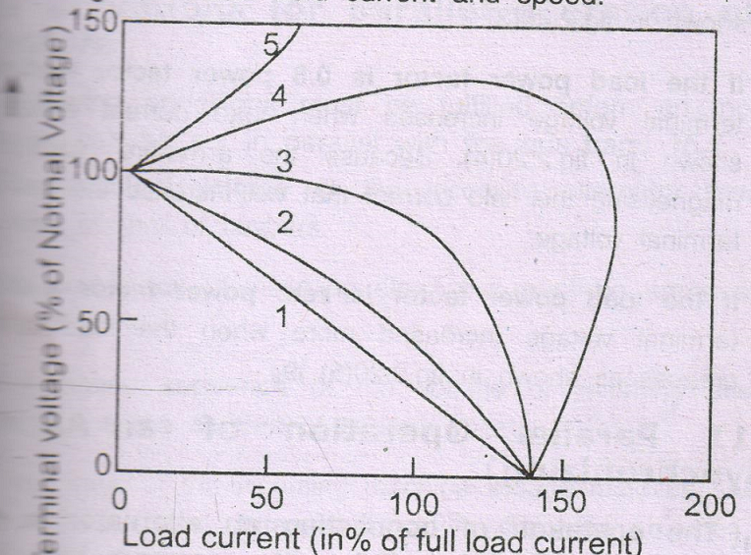
Load characteristics of an Alternator
1. Zero PF lag 2.0.8 pf lag , 3.unity pf, 4.08 pf lead, 5. 0 pf lag

Slide 54
Voltage regulation of an alternator
E - V
% Regulation = * 100
V
Where E is the no load terminal voltage
V is the full load terminal voltage

Slide 55
Voltage regulation of an alternator
Generally the alternator working at upf has 10% regulation maximum and at lagging powerfactor has 30% regulation .
Voltage difference (E-V) depends an effective armature resistance ( Reff) and synchronous reactance (Xs)
Less amount of % regulation indicates the good performance of the alternator
% Regulation is +ve value for unity and lagging power factor load
% Regulation is –ve value for leading power factor load.

Slide 56
Determination of Regulation
By Direct method :
In this method no load voltage of an alternator is taken as induced emf ‘ E’ .
Then alternator is loaded step by step directly
Each load condition terminal voltage (V) is noted down
% Regulation = (E- V / V ) * 100
In this method power is wasted hence it is used for small ratings .

Slide 57
Predetermination of Regulation
EMF Method ( Synchronous –impedance method)
MMF Method ( Ampere turn method)
ZPF Method ( Zero power factor method ) or potier method

Slide 58
Testing of Alternator
Performance can be studied from -
Direct method
Indirect method
Direct method : it is loaded directly in step by step upto full load . A curve is drawn between load current and terminal voltage at each load condition .
Indirect method : In this method it is not loaded directly . Here open circuit and short circuit tests are carried out to study the performance of an alternator at various load condition .

Slide 59
Parallel operation
Advantages of parallel operation
1. It increases the load capacity
2. Increases reliability
3. one or more of them can be shut down for preventive maintenance
4. Less efficient machines can be stopped

Slide 60
Conditions for parallel operation
1. same terminal voltage
2. same frequency
3. same phase sequence
Methods for synchronising:
a. Dark lamp method
b. Bright lamp method
c . Synchroscope Method

Slide 61
Load sharing
Speeds are identical
Common terminal voltage
Load impedance Z1 = Z2
Load sharing is ἀ driving torque and its capacity

Slide 62
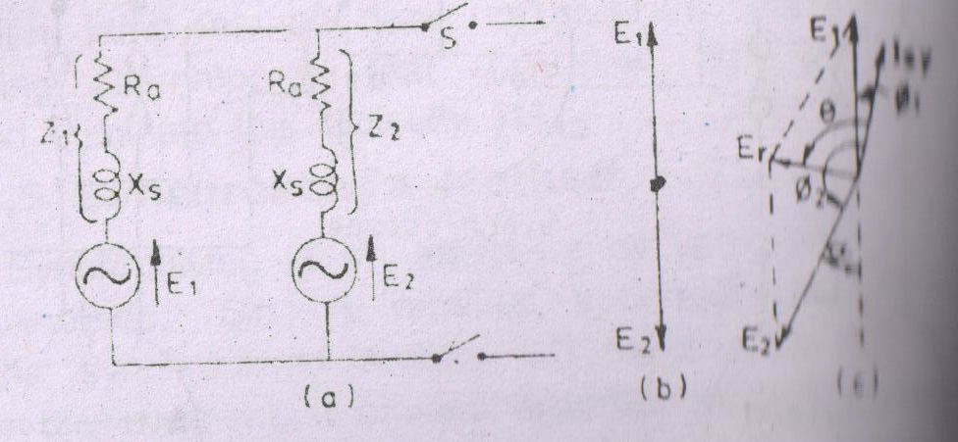
Load sharing

Slide 63
Effects of change in steam supply
Excitations of two alternators are kept constant
Steam supply to alternator 1 is increased ( ie power input to the prime mover is increased
Speed of two machines are tied together
Machine no 1 can not over run machine no2 .
Alternatively it utilises its increased power input for carrying more load than No2.
This can be possible only if rotor no 1 advances its angular position with respect to No2.
Power factor of NO1 is increased where as No2 is decreased .
It sets up Isy has no appreciable reactive component .
It increases the active power output of No1.

Slide 64
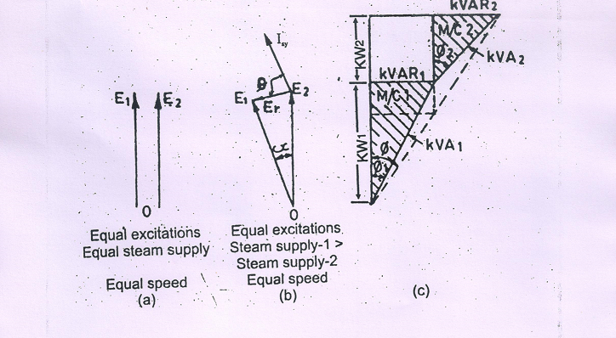
Alternators in parallel when steam input to No1 is increased

Slide 65
Effects of change in steam supply
Excitation of No 1 is increased . Induced EMF in No 1 will be increased
Hence circulating current flowing thro local circuit .
Is = ( E1 – E2) / 2Z
This current is 90° lagging to the terminal voltage V of the alternator
No1 supplies current which is the vector sum of I1 and Is ( ie ¡’ = ¡1+¡s)
No 2 supplies a current of I’2
From the vector diagram PF of the No1 is reduced .
Active component does not vary.

Slide 66
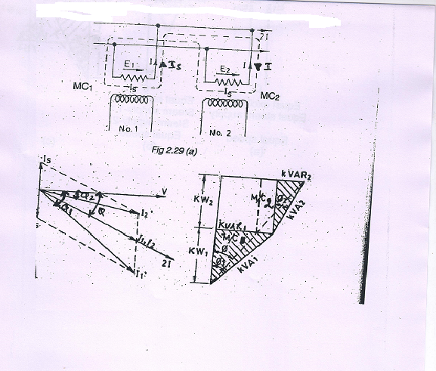
Effects of change in excitation of alternators in parallel (control of reactive power kVAR generation)

Slide 67
Applications
Standby gensets
Welding plants

Slide 68
Summary
Load taken by the alternator is directly depends upon its driving torque
Excitation merely changes the power factor
Input constant but its excitation is changed then kVA component of the alternator is changed not kW
Notes:
r

Slide 69
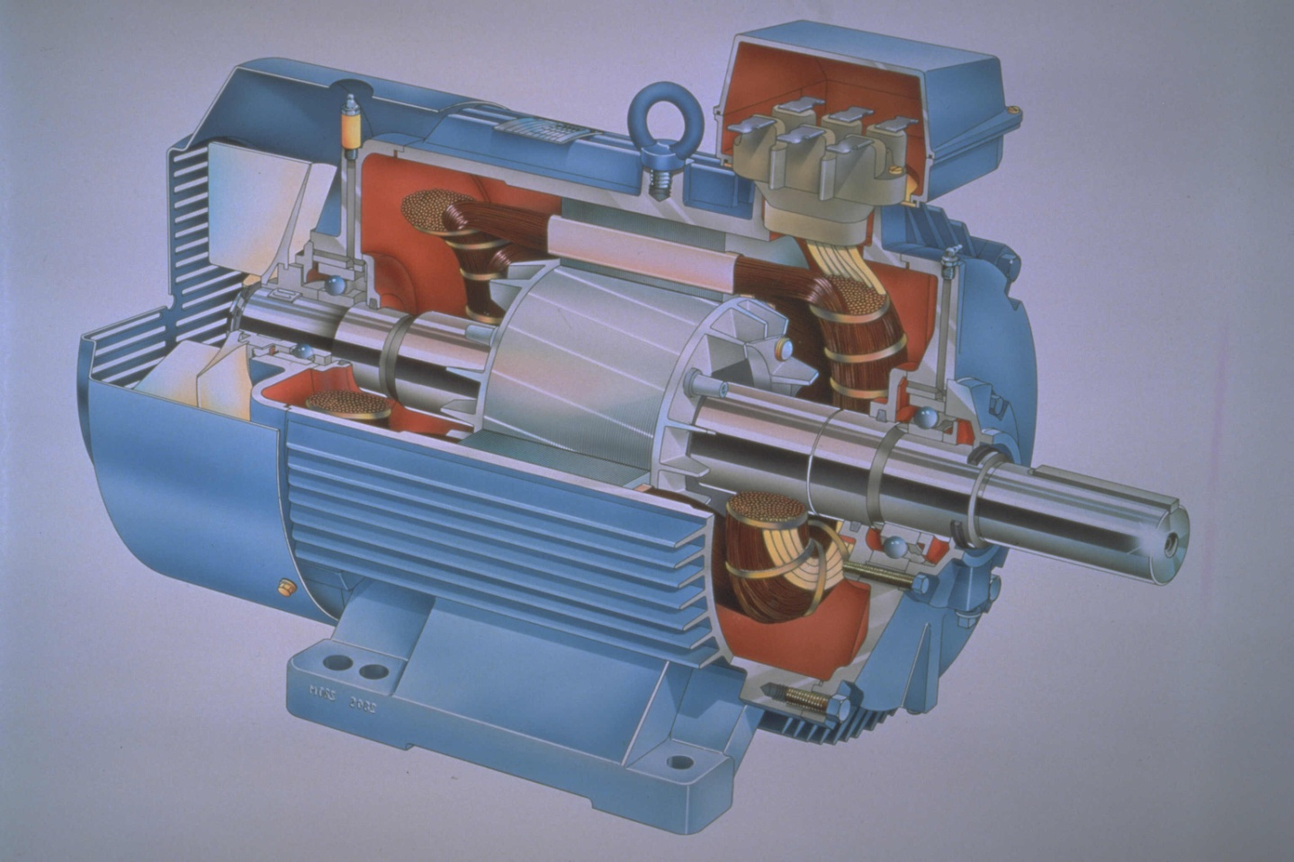
Three phase induction Motor

Slide 70
Three phase induction Motor
Introduction:
Generation of AC supply is easier.
It can be step up and step down easily.
It can be rectified to DC.
Common and frequently used in Industries.
Advantages :
1. Simple construction 2. High reliability
3. Low cost 4. High efficiency
5. Less maintenance 6. Self starting
7. Good power factor

Slide 71
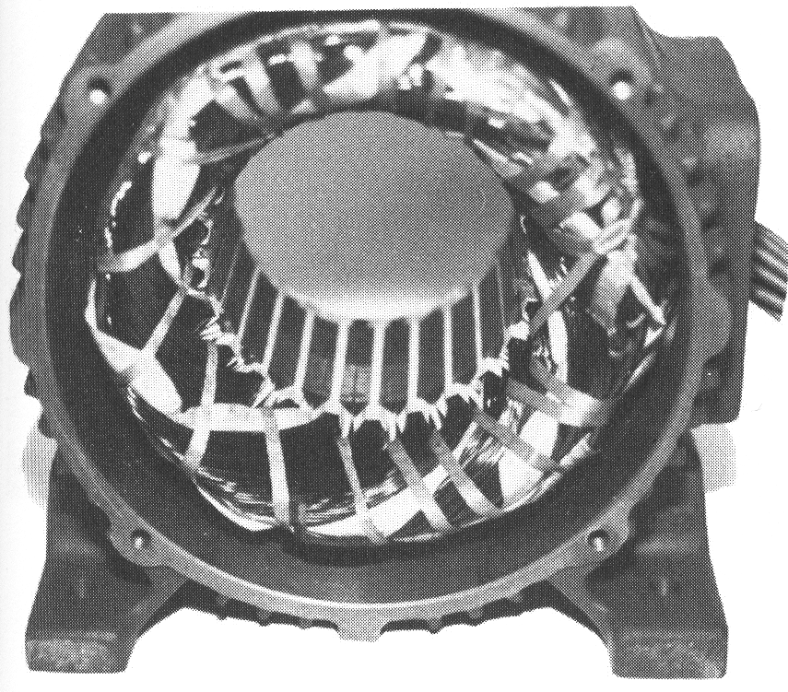
Constructional Details
Two main parts of induction Motor - Stator & Rotor
1. A Stationary stator
    consisting of a steel frame that supports a hollow, cylindrical core
    core, constructed from stacked laminations (why?), having a number of evenly spaced slots, providing the space for the stator winding

Slide 72
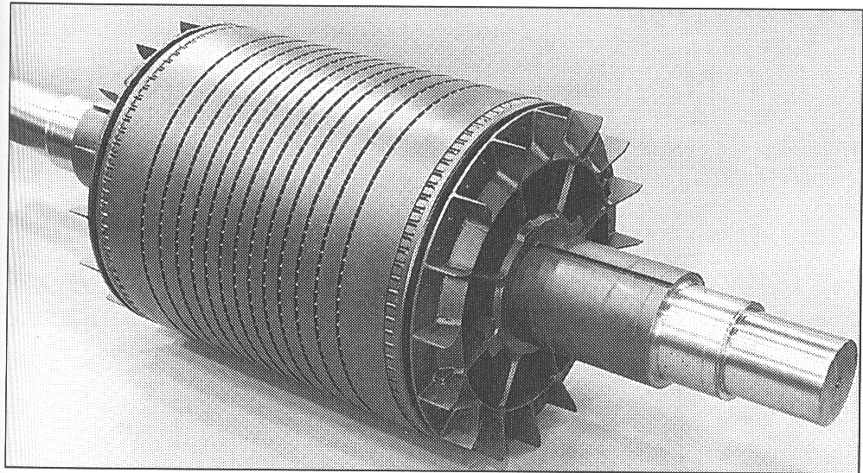
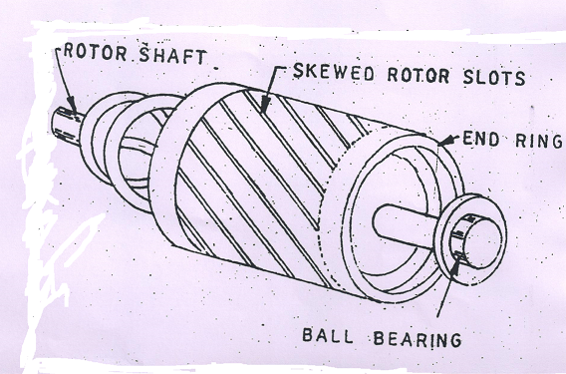
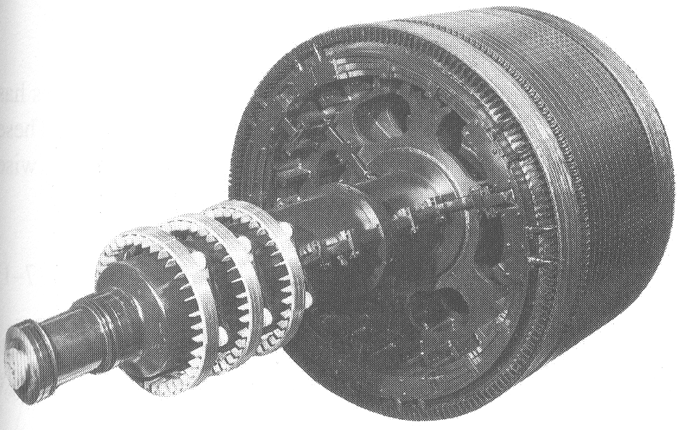
Rotors
Squirrel cage rotor
Wound rotor
Notice the slip rings

Slide 73
2. A Revolving rotor-
Composed of stacked laminations with rotor slots for the rotor winding with any one of two types of rotor windings
i. Conventional 3-phase windings made of insulated wire
ii. Aluminum bus bars shorted together (squirrel-cage)
Two basic design types of rotor:
Squirrel-cage:
Conducting bars laid into slots and shorted at both ends by shorting rings.
Wound-rotor:
Complete set of 3Φ windings usually Y-connected, the ends of the rotor wires are connected to 3 slip rings on the rotor shaft.
External resistance is connected in each winding at starting. So it reduce the starting current and improve the p.f of the rotor
Higher rotor resistance at starting increases the starting torque.
As the motor speeds up resistance in the rotor circuit is cut step by step and finally the rotor is short circuited .

Slide 74
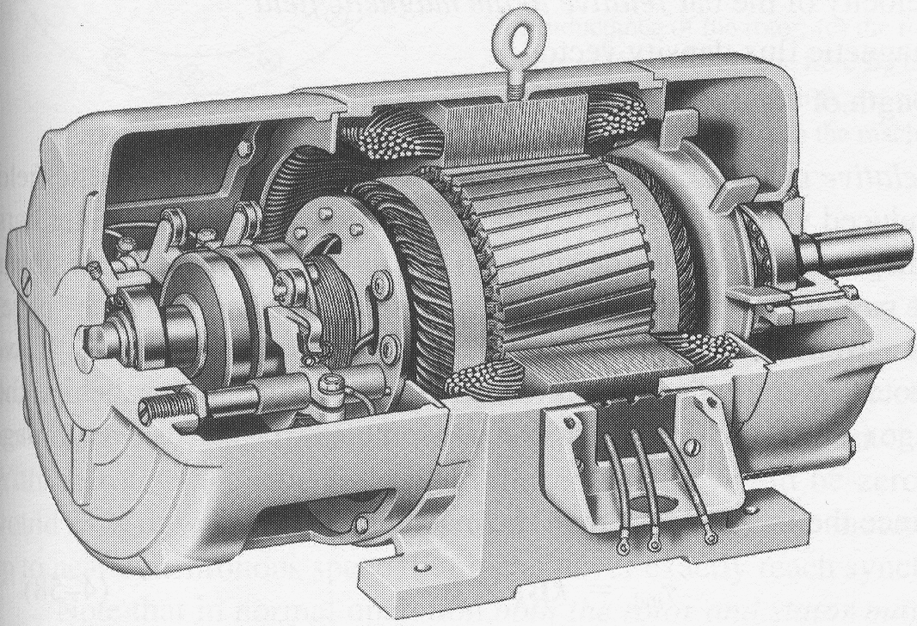
Construction
Slip rings
Cutaway in a typical wound-rotor IM. Notice the brushes and the slip rings
Brushes

Slide 75
Types of Induction motor
Sl.No | Squirrel cage motor | Slip ring motor
1 | Construction is very simple | Rotor has winding . So the construction is not simple
2 | Low cost | High cost
3 | Less starting torque | High starting torque
4 | High efficiency | Low efficiency
5 | power factor is less | Power factor is high
6 | High starting current | Low starting current
7 | No slip ring and no sparks | Brushes on the slip ring makes spark

Slide 76
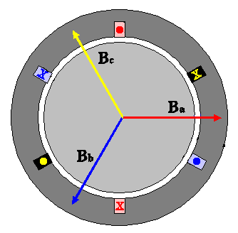
Rotating Magnetic Field
Balanced three phase windings, i.e. mechanically displaced 120 degrees form each other, fed by balanced three phase source
A rotating magnetic field with constant magnitude is produced, rotating with a speed
Where f_{e} is the supply frequency and
P is the no. of poles and
n_{sync} is called the synchronous speed in rpm

Slide 77
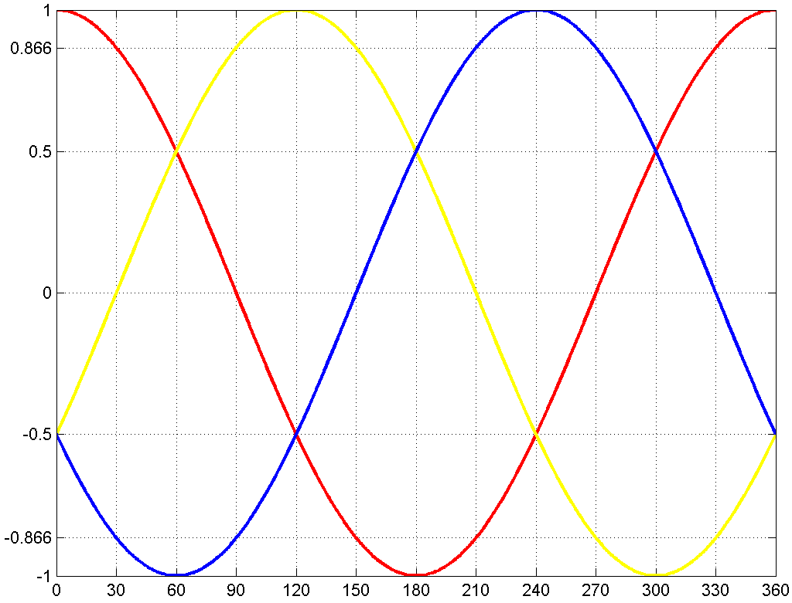
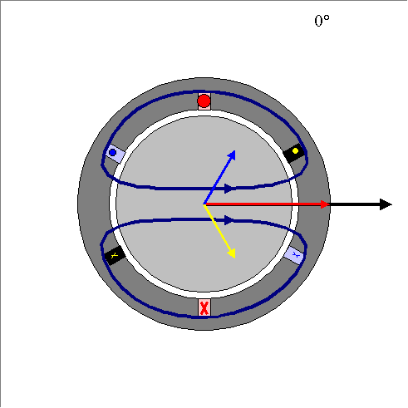
Rotating Magnetic Field

Slide 78
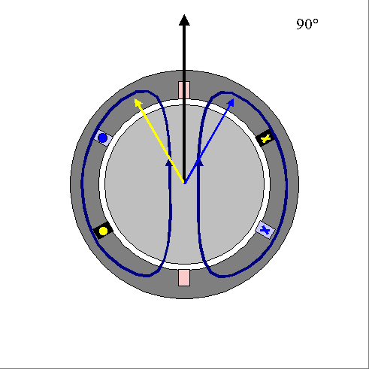
Rotating Magnetic Field

Slide 79
Rotating Field – Direction of rotation
The phase current waveforms follow each other in the sequence A-B-C.This produces a clockwise rotating magnetic field.
If we interchange any two of the lines connected to the stator, the new phase sequence will be A-C-B.This will produce a counterclockwise rotating field, reversing the motor direction.l;

Slide 80
No of Poles and Synchronous Speed
P | 50 Hz | 60 Hz
2 | 3000 | 3600
4 | 1500 | 1800
6 | 1000 | 1200
8 | 750 | 900
10 | 600 | 720
12 | 500 | 600

Slide 81
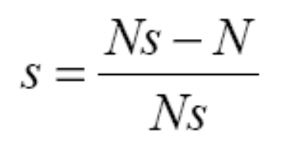

Induction Motors Slip
The difference between the synchronous speed and rotor speed can be expressed as a percentage of synchronous speed, known as the slip:
where
s = slip,
Ns = synchronous speed (rpm),
N = rotor speed (rpm)
At no-load, the slip is nearly zero (<0.1%). At full load, the slip for large motors rarely exceeds 0.5%. For small motors at full load, it rarely exceeds 5%. The slip is 100% for locked rotor.
X 100 %

Slide 82
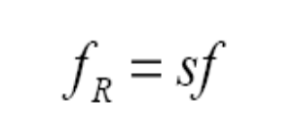
Frequency Induced In the Rotor
The frequency induced in the rotor depends on the slip:
When the rotor is blocked (s=1) , the frequency of the induced voltage is equal to the supply frequency
If the rotor runs at synchronous speed (s = 0), the frequency will be zero
where
f_{R} = frequency of voltage and current in the rotor,
f = frequency of the supply
s = slip

Slide 83
Induction motor speed
  If the rotor runs at the speed the same as speed of the rotating magnetic field, then the rotor will appear stationary and the rotating magnetic field will not cut the rotor. So, no induced current will flow in the rotor andso no torque is generated and the rotor speed will fall below the synchronous speed
  When the speed falls, the rotating magnetic field will cut the rotor windings and a torque is produced

Slide 84
Induction motor speed
So, the IM will always run at a speed lower than the synchronous speed
The difference between the motor speed and the synchronous speed is called the Slip
  Where n_{slip}= slip speed
  n_{sync}= speed of the magnetic field
  n_{m} = mechanical shaft speed of the motor

Slide 85
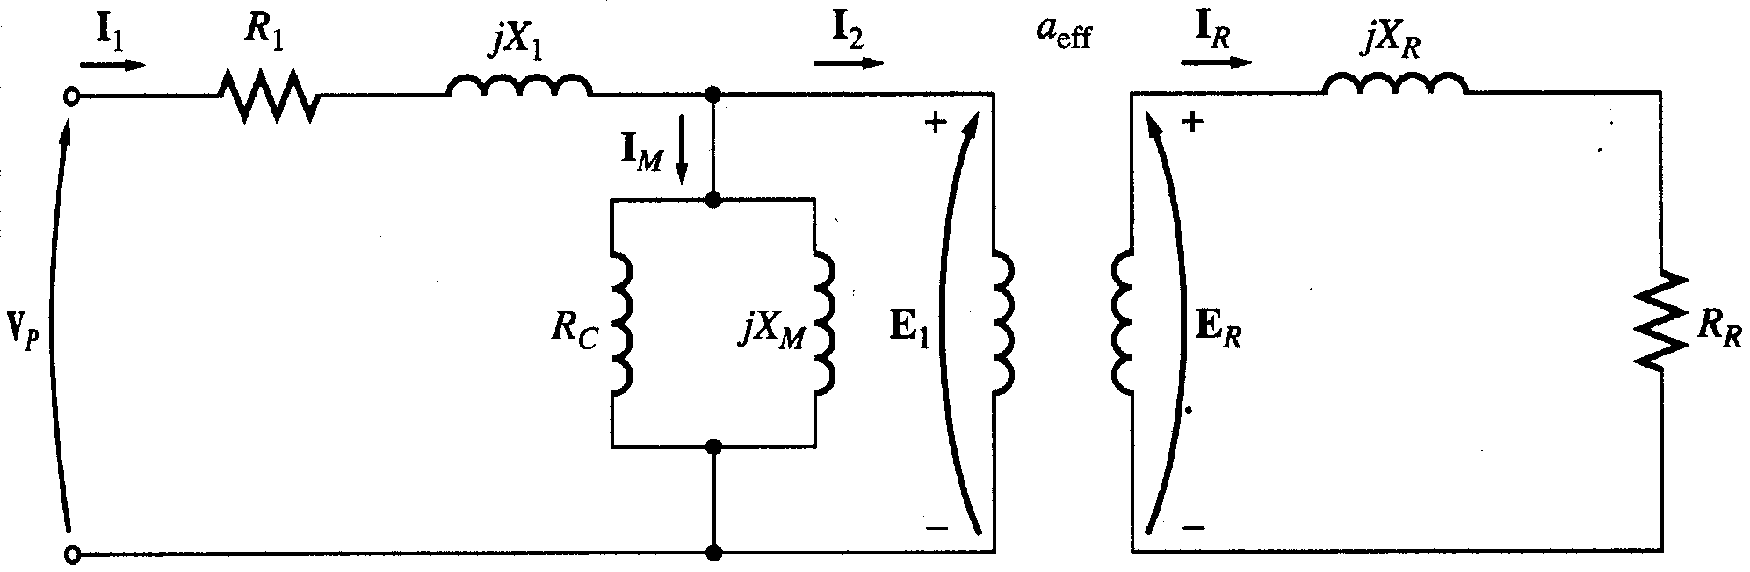
Equivalent Circuit
The induction motor is similar to the transformer with the exception that its secondary windings are free to rotate
  As we noticed in the transformer, it is easier if we can combine these two circuits in one circuit but there are some difficulties

Slide 86
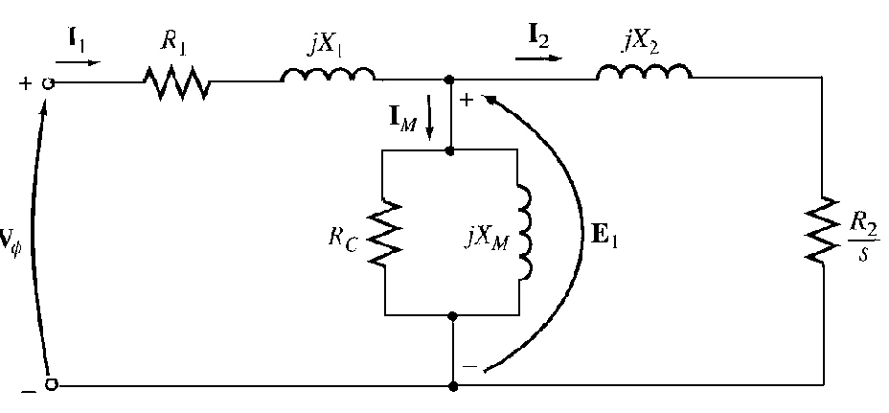
Induction Motors Equivalent circuit
An induction motor can be described as rotating transformer, it is input is three phase voltage and current, the output of IM is shorted out so no electrical output exist, instead the output is mechanical.
The Per phase equivalent circuit of an induction motor:

Slide 87
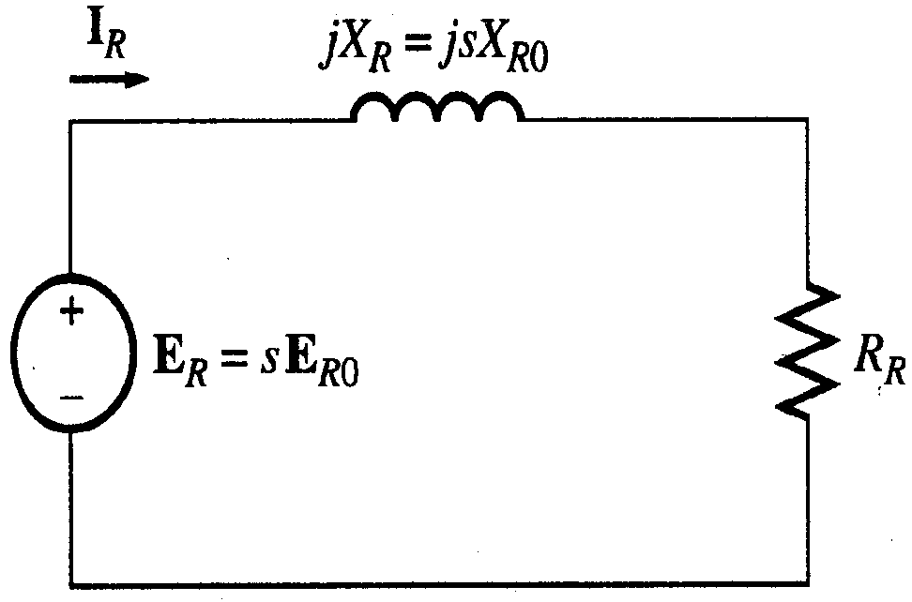
Rotor Equivalent Circuit
We can calculate the rotor current
Dividing both the num. and
deno. by s so nothing changes we get

Slide 88
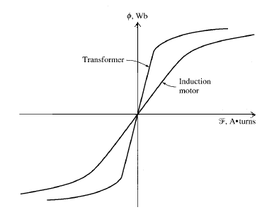
Transformer model of induction motor
Magnetization curve of induction motor

Slide 89
Horse power
Another unit used to measure mechanical power is the horse power
It is used to refer to the mechanical output power of the motor
Since we, as an electrical engineers, deal with watts as a unit to measure electrical power, there is a relation between horse power and watts

Slide 90
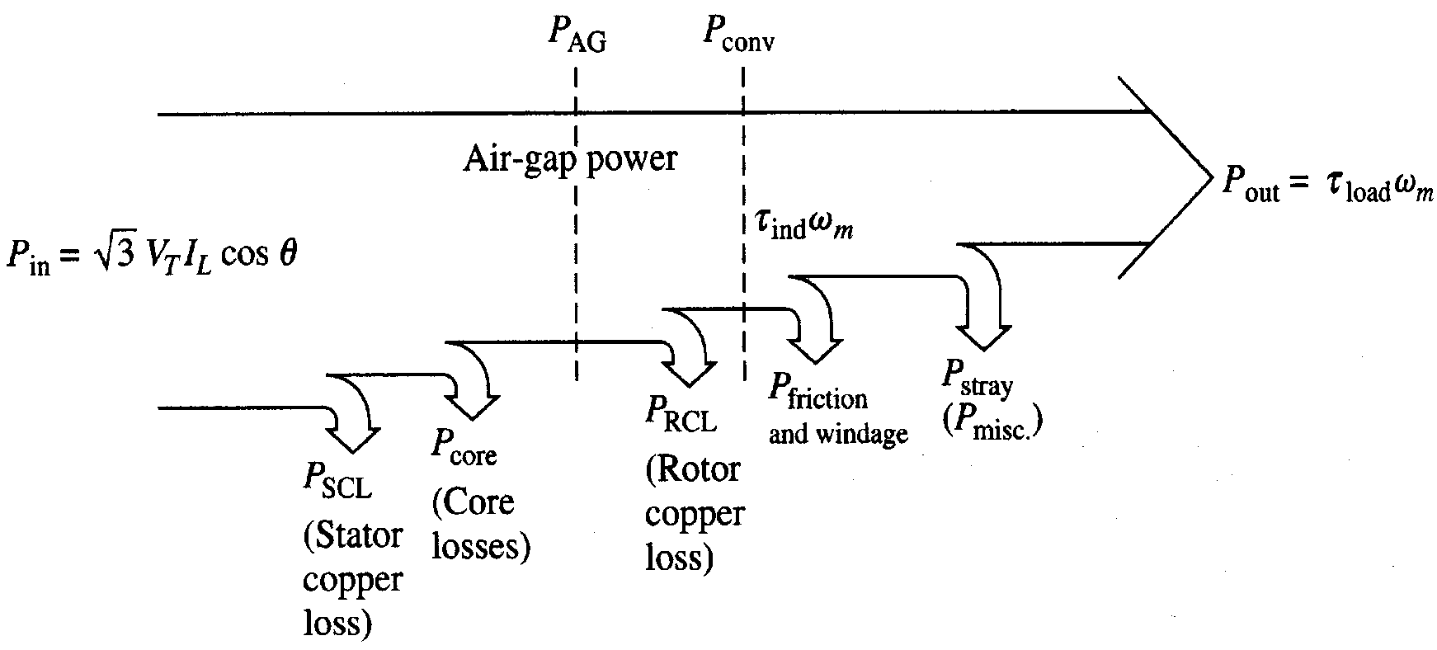
Power flow in induction motor
Copper losses
  Copper loss in the stator (P_{SCL}) = I₁²R₁
  Copper loss in the rotor (P_{RCL}) = I₂²R₂
Core loss (P_{core})
Mechanical power loss due to friction and windage
How this power flow in the motor?

Slide 91

Power relations
1
1-s
s

Slide 92
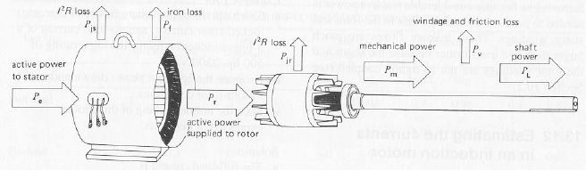
Power Flow

Slide 93
Induction Motor Efficiency and Torque
The Motor efficiency:
Motor torque:

Slide 94
IM Torque-Speed Characteristic
At light loads:
The rotor slip is very small
The relative motion is very small and the rotor frequency is also very small.
Current and ER is very small and in phase.
So BR is relatively small, as the rotor magnetic field is very small then the induced torque is small.
At heavy loads:
  As load increase, the slip increase, rotor speed falls down,
  More relative motion appears and produce stronger E_{R},
  larger rotor current I_{R} and so rotor magnetic field B_{R} will be seen.
  The angle of the rotor current will be also changed.
  The increase in B_{R} tend to increase in the torque.

Slide 95
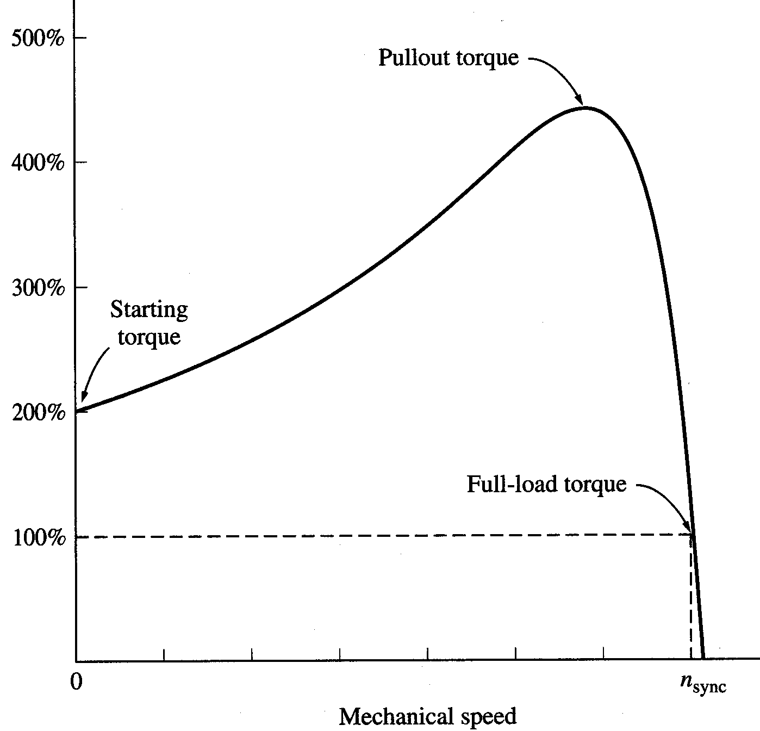
Torque-speed characteristics

Slide 96
Starting torque: is 200-250% of the full load torque (rated torque).
Pullout torque: Occurs at the point where for an incremental increase in load the increase in the rotor current is exactly balanced by the decrease in the rotor power factor. It is 200-250 % of the full load torque.
96

Slide 97
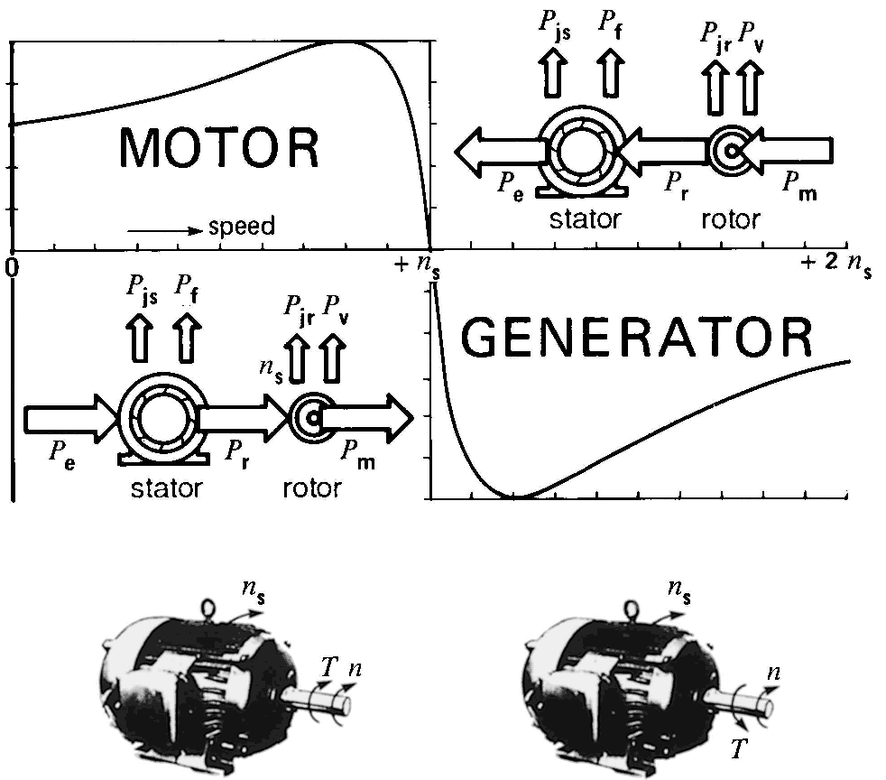
Induction Motor/Generator Mode

Slide 98

Maximum torque
Maximum torque occurs when the power transferred to R₂/s is maximum.
The corresponding maximum torque of an induction motor equals
The slip at maximum torque is directly proportional to the rotor resistance R₂
The maximum torque is independent of R₂

Slide 99
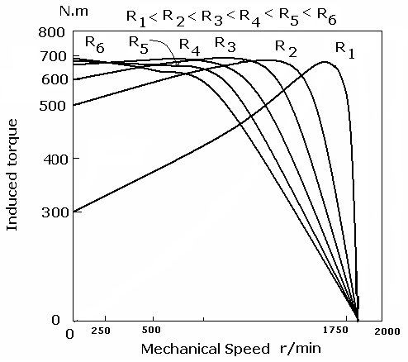
Effect of Varying Rotor Resistance in wound rotor IM

Slide 100
Determination of motor parameters
Due to the similarity between the induction motor equivalent circuit and the transformer equivalent circuit, same tests are used to determine the values of the motor parameters.
  DC test: determine the stator resistance R₁
  No-load test: determine the rotational losses and magnetization current (similar to no-load test in Transformers).
  Locked-rotor test: determine the rotor and stator impedances (similar to short-circuit test in Transformers).

Slide 101
Applications of Induction motors
Fans and blowers
All pumps
Lathes, drilling machines and grinding machines
Rolling mills , Compressors
Crushers, Cranes , hoist and conveyors etc.

Slide 102
Thank you

